Slide 1

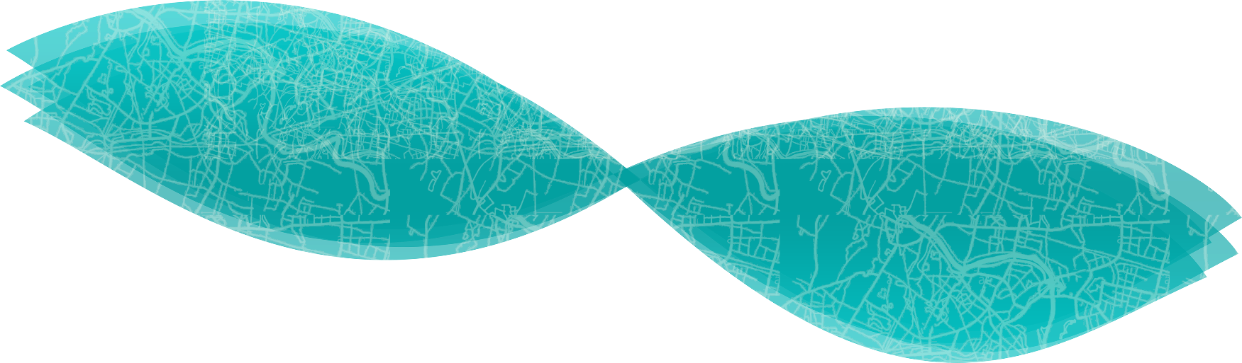
Crime rate prediction
using K Nearest Neighbor.

Slide 2

Project by:
Anshika Awasthi [1805213011]
Ashutosh Yadav [1805213016]
Shadan Amir [1805213052]
Supervisor:
Dr. Pawan Kumar Tiwari
Co-supervisor:
Miss. Mudita Sharan

Slide 3
Introduction
Crimes are treacherous and common social problem faced throughout the world. Crimes affect the quality of living, economic growth, and reputation of a nation. There has been a great increase in crime rate in the last few years. In order to cut down the crime rate, the law enforcements need to take strong preventive measures. With the aim of saving the society from crimes, there is a need for advancement in systems and new approaches for improving the analysis of crime for protecting their communities. Accurate real-time c predictions of crime help to reduce the crime rate but remains challenging problem for the scientific community as crime occurrences depend on enormous number of complex factors.

Slide 4
Need
The crime rate registered in India per lakh population showed a dramatic increase from 385.5 in 2019 to 487.8 in 2020 even in the state of complete lockdown. As much as these enormous digits are intimidating, they can be harnessed to prevent their onset in the first place. This crime data can be analyzed through rigorous machine learning models to identify intricate patterns and to:
predict the likelihood of such upcoming events with high precision. This can aid individuals to avoid being caught up in such scenarios.
help government bodies to be better prepared to respond to such threats.

Slide 5
Proposed Model
We aim to develop through extensive research, a usable and reliable solution to the problem of unsafe navigation using Maps. The current map applications employ the best of world-class technologies to suggest routes that reduce the navigation duration to the minimum. While they incorporate factors like real-time traffic, they fail to consider safety as the most crucial aspect of this experience. We attempt to bridge this gap and make navigation more comfortable and safer for billions of people that rely on maps to guide their ways.

Slide 6
Features
Crime analysis(increment/decrement) in a area
Coloring the areas on map crime rate wise.
Crime wise distribution
Latitude and longitude wise distribution
Crime act wise distribution
Map Navigation

Slide 7
Recent developments in the field
Though the advent of the Big Data era and the availability of fast, efficient algorithms for data analysis has created a spur in the research work being done in the field of understanding patterns in this crime data, the greatest hurdle is the collection of data. Major database problems can be compiled as:
For extracting relevant information, one must sift through piles of data manually.
More time is needed in searching for the required information.
Many hard copies are required to be referred.
Access to it is not available anywhere.
It is not possible to keep all the records in memory or a file because of the large data which they comprise.
A large amount of data maintenance is the big problem; searching and predicting a particular data manually is not possible from the files.
Several projects have employed used Apriori and multiple linear regression to effectively predict upcoming events, but they’re limited to complex web apps. There is no existing system for this project, here in India.

Slide 8
Methodology
• Machine learning (ML) is the study of computer algorithms that can improve automatically through experience and using data.
• Machine learning algorithms build a model based on sample data, known as training data, to make predictions or decisions without being explicitly programmed to do so.
• Independently generate solutions, the prior action of people is necessary. For example, the algorithms which are required and the data must be fed into the systems in advance and the respective analysis rules for the recognition of patterns in the data stock must be pre-defined.

Slide 9
Methodology (contd)
Here we are using the K nearest neighbors' algorithm to analyze the data.
K-Nearest Neighbor is one of the simplest Machine Learning algorithms based on the Supervised Learning technique.
K-NN algorithm assumes the similarity between the new case/data and available cases and puts the new case into the category that is most like the available categories.
K-NN algorithm stores all the available data and classifies a new data point based on the similarity. This means when new data appears then it can be easily classified into a good suite category by using K- NN algorithm.
K-NN is a non-parametric algorithm, which means it does not make any assumption on underlying data.
It is also called a lazy learner algorithm because it does not learn from the training set immediately instead it stores the dataset and at the time of classification, it performs an action on the dataset.
KNN algorithm at the training phase just stores the dataset and when it gets new data, then it classifies that data into a category that is much similar to the new data.

Slide 10
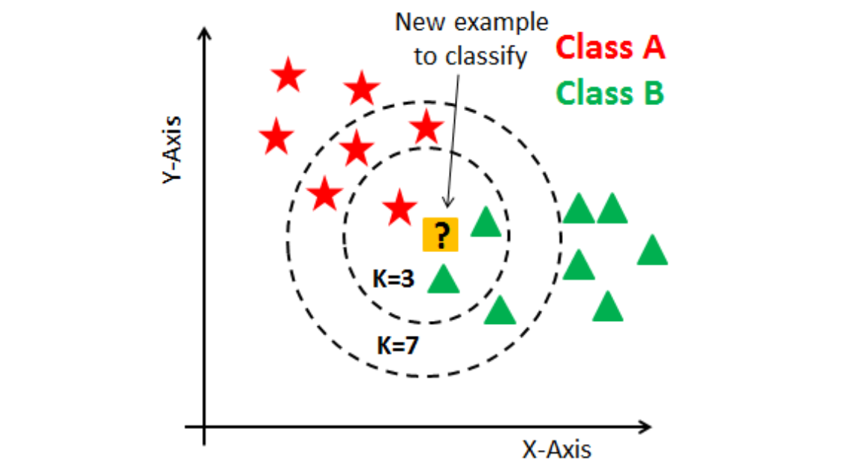
Classification using KNN

Slide 11
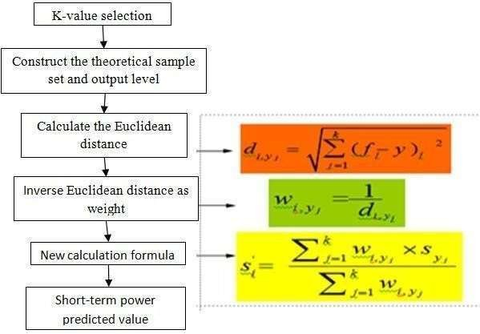
KNN (contd.)
Steps to take when using the K-means algorithm are as follows:
Assume that X represents the data clusters as a vector and the V represents the points of centers assets.
• Clustering centers are denoted by the letter ‘c.’
• Assign the information objects to the cluster center with the shortest distance from all other cluster centers.
• Build a new cluster core using the formula.
• Measure the distance between each cluster center and each data point.
• Repeat from step 3 onwards again, if no data points are assigned.

Slide 12
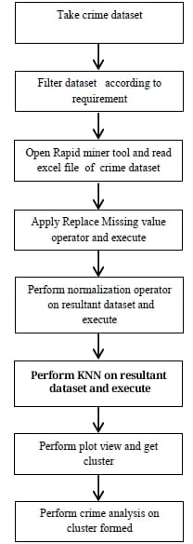
Data flow diagram
Steps:
Collected crime data set from Indore Police database- data comprises of five criminal offences and location in and around the vicinity of Madhya Pradesh.
Removed misguiding data and added missing datasets.
Visualized the datasets using Matplotlib and Seaborn libraries.
Performed KNN on the resultant dataset.
Integrated front end for webapp.

Slide 13
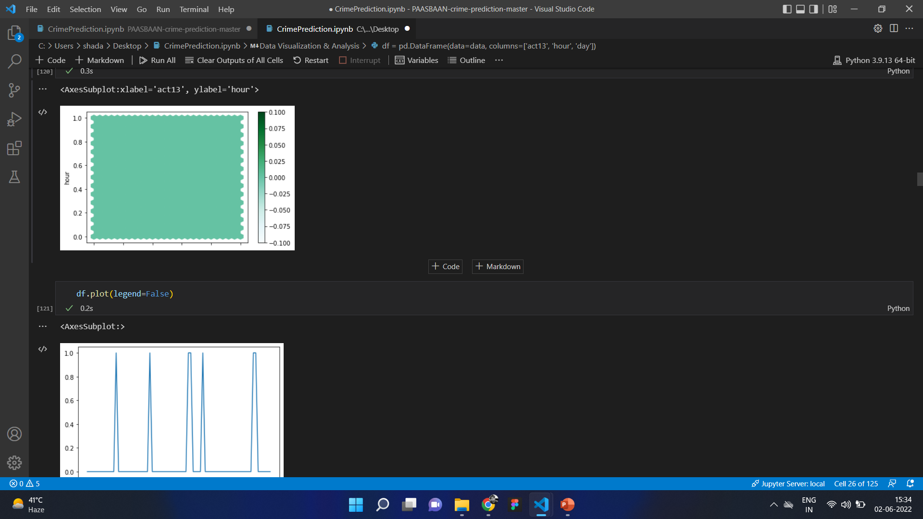
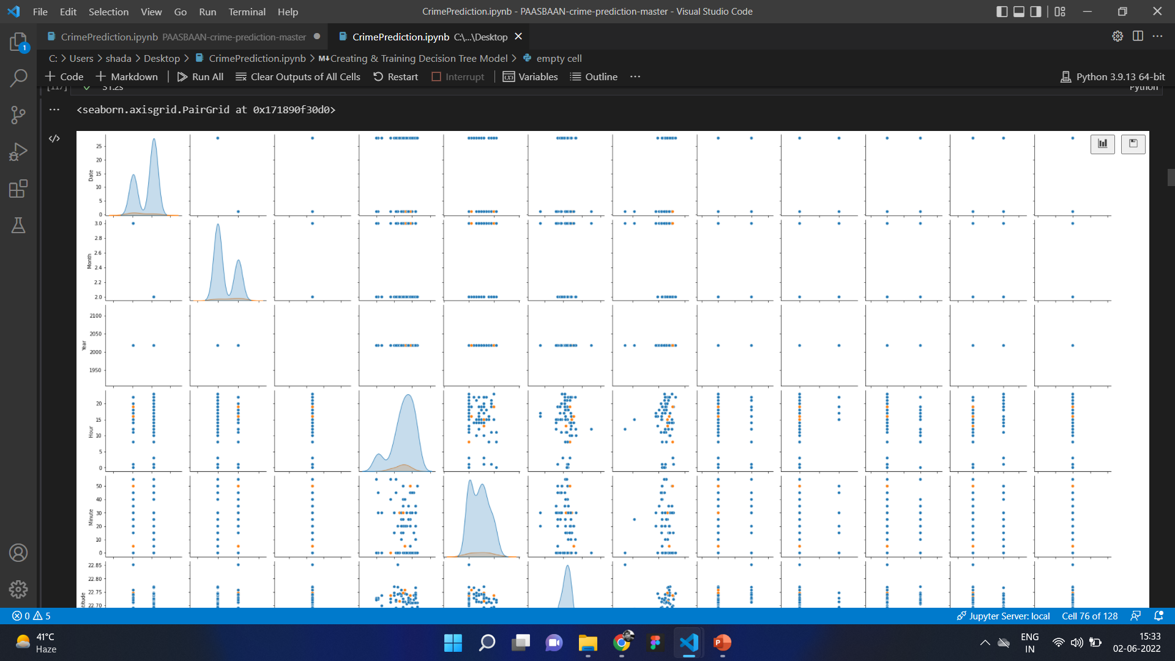
Data visualization using seaborn and matplotlib

Slide 14
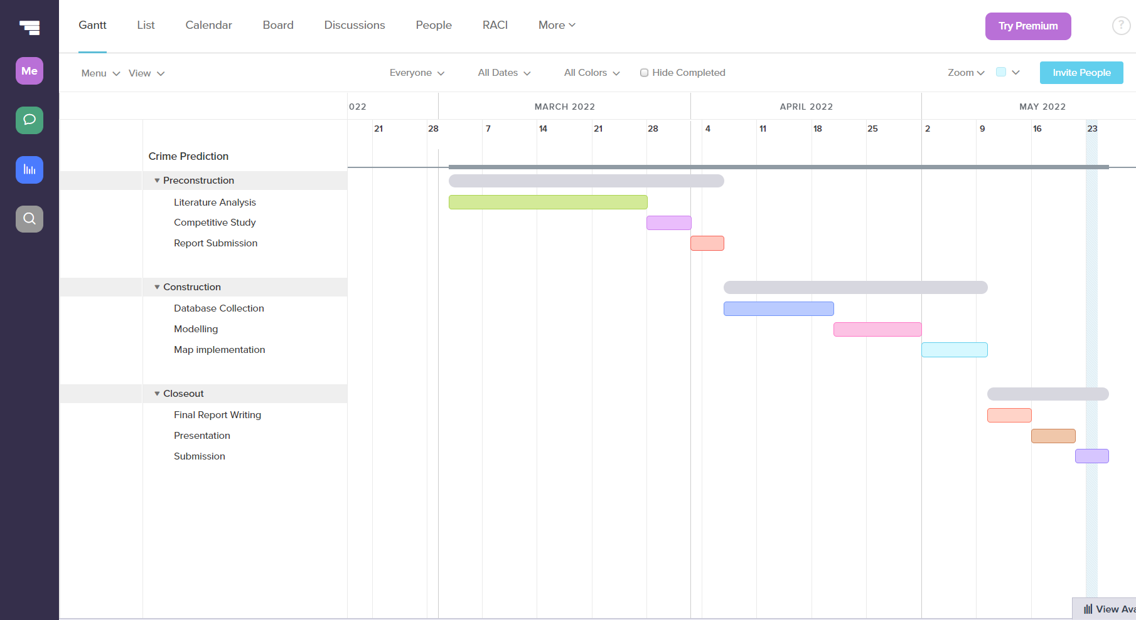
Plan of work

Slide 15
Plan of work
• Literature Analysis: This includes a detailed analysis of the prominent work being done in the field. This also included the secondary and the primary research
• Problem statement: We employed the ‘Double diamond’ approach to define our problem statement more specifically.
• Database collection: This phase included a collection of crime data from different sources such as government websites and police/crime bureau portals. This is a tedious task consisting of unorganized and scattered data points that are available online.
• Modeling: This includes structuring of the database collection and application of all the algorithms to predict potential threats as explained in the previous sections of the report.
• Map Implementation: The final phase of the project includes the application of predicted data to the map API to develop an easily accessible tool for safer navigation.

Slide 16
Conclusion and future work
Machine learning is an extremely ground-breaking field with regards to AI and, if a model is done well, the degree of precision that a few calculations accomplish can be bewildering. Unquestionably, the present and eventual fate of wise frameworks experience ML and huge information analysis. During classification, KNN with various portions connected on Crime dataset.
Information is approved through Training and Cross-Validation criteria.
The final stage of the project includes the application of predicted data to the map API to develop an easily accessible tool for safer navigation.

Slide 17
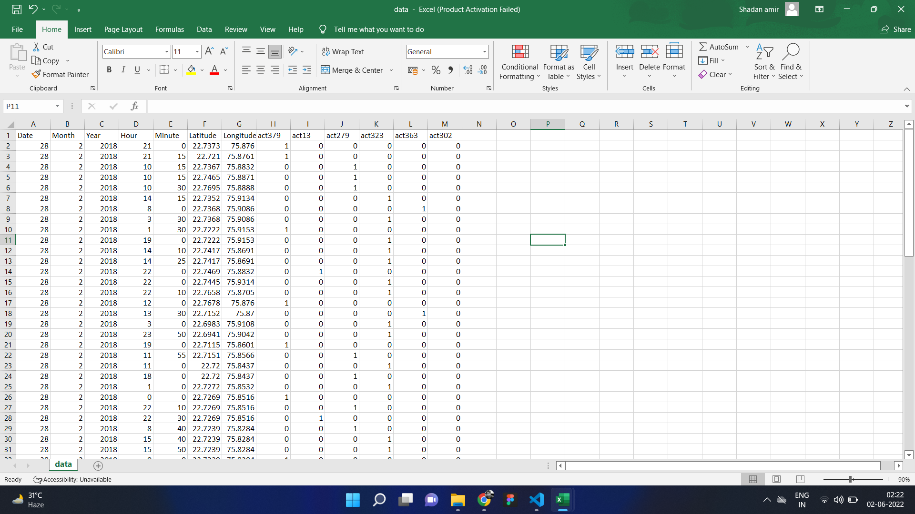

Slide 18
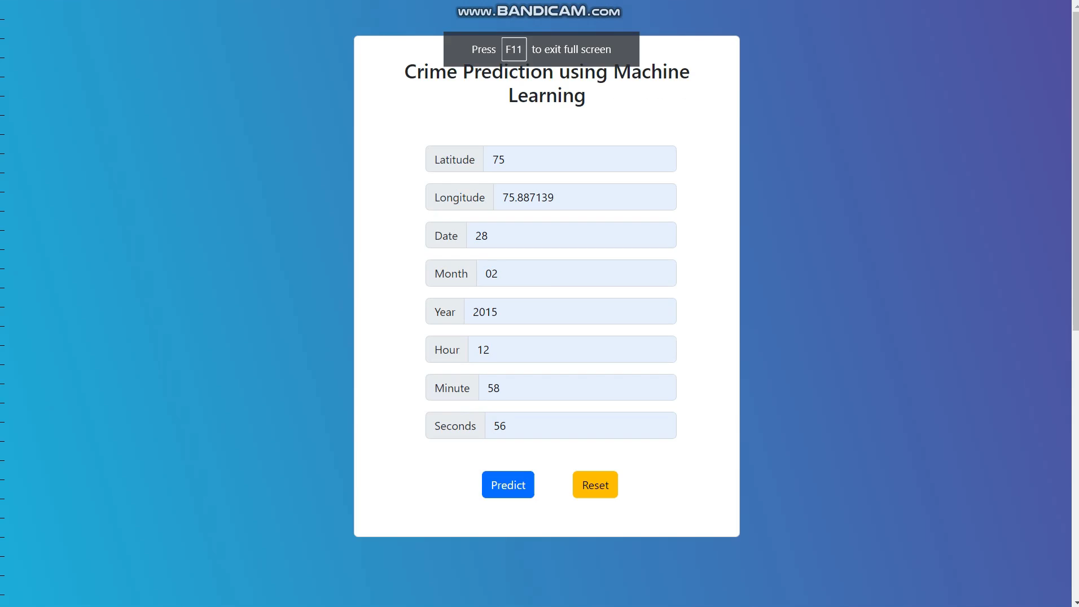

Slide 19
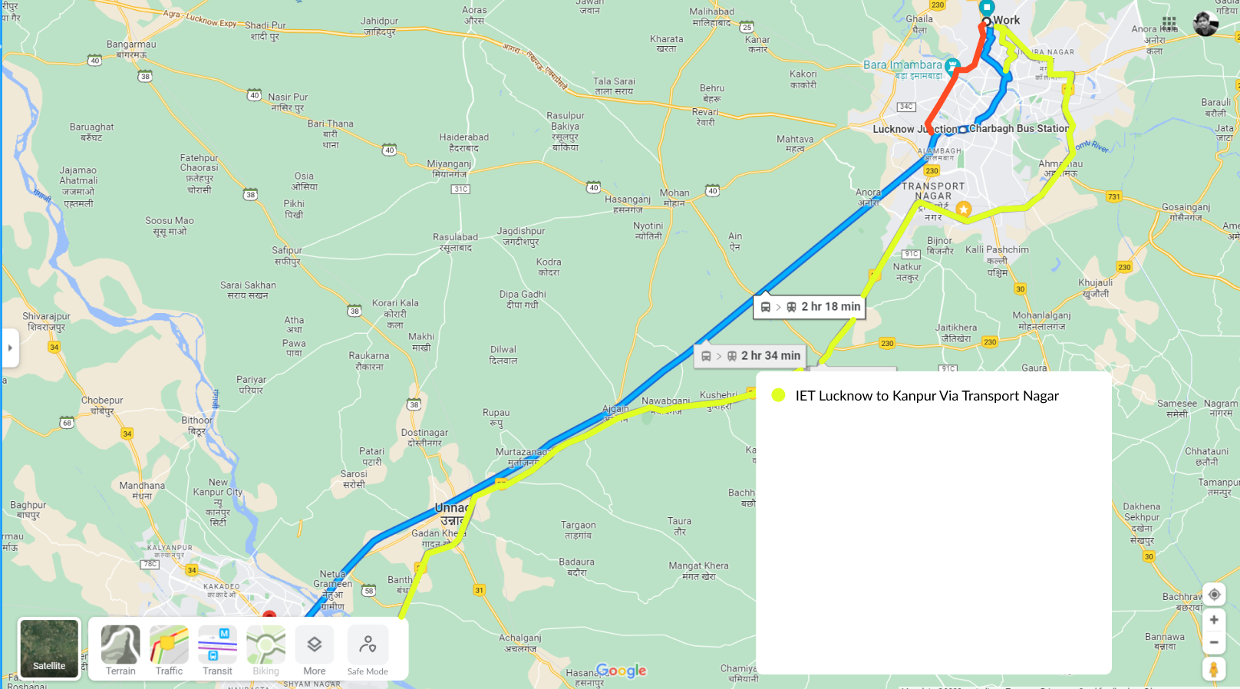

Slide 20
References
[1] Ch. Mahendra, G. Nani Babu, Balu Nitin Chandra, A. Avinash, Aditya. “Crime Rate Prediction” Vol 11. [Issued- 5 May 2020]
[2] Amrit Ghosh, Arpan Roy Chaudhary, Aviroop Saha, Krishne Dukundu. “Crime Prediction Analysis” Submitted to KIIT
Deemed tobeUniversity. [Dated- April, 2020]
[3] “Volume I Statistics” Available: https://ncrb.gov.in/en/Crime-in-India-2020 [2019]
[4] “Way Better! – Find the Safe Way App Service” Available: https://www.behance.net/gallery/67893883/Way-Better-Find-
the-Safe-WayAppService [Issued- 2019]
[5] Dewashish Kumar, Abhinash Kumar, Dr.S. Gowri, Dr. A. Sivasangari4, Ms. J. S. Vimali5, Dr. G. Roslinenesa Kumari.
“Predicting The Rate of Crime Using K Means”. [Issued 2019]
[6] ToppiReddy, Hitesh Kumar Reddy, Bhavna Saini, and Ginika Mahajan. "Crime prediction & monitoring framework based
on spatial analysis." Procedia computer science [Issued- 2018].
[7] Kunal Diwan, Sahitya Nigam, Saurabh Tiwari, Vikramaditya Singh Bhati. “PAASBAAN – Crime Prediction and Classification
in Indore City” submitted to Rajiv Gandhi Proudyogiki Vishwavidyalaya, Bhopal. [Issued: 2018]
[8] Oren Anava, Kr Y. Levy “K-Nearest Neighbors: From Global to Local” [April 2017]
[9] Ping Li, Jianping Gou, Hebiao Yang, “The Distance-Weighted K-nearest Centroid Neighbor Classification”, Volume 8,
Number 3 [Issued: May 2017]
[10] Aghababaei, Somayyeh and Masoud Makrehchi. “Mining social media content for crime prediction.” IEEE/WIC/ACM
International Conference on Web Intelligence (WI). [June 2016]
[11] Ming Zhao, and Jingchao Chen, “Improvement and Comparison of Weighted k Nearest Neighbors Classifiers for Model
Selection”, Volume 10 [Issued: 2016].
[12] Ming Zhao, and Jingchao Chen, “Improvement and Comparison of Weighted k NearestNeighbors Classifiers for Model
Selection”, [Issued- 2016].

Slide 21
Thank You

